Slide 1
Amputation Prevention Training
Machine Guarding – Hazardous Energy Control- Safe Work Practices
Notes:
Within the printing industry, working with and around powered machines can be relatively safe when the equipment is properly guarded, safe work practices are established and followed, and when employees are effectively trained.
However, when severe impacting injuries to hands and arms are experienced these types of injuries can often result in amputation or other permanent disability. Severe injuries and amputations can occur from the use and maintenance of powered machines when unsafe work practices and non-compliant conditions are involved.
As employees assigned to operate powered machines, perform minor service or extensive service and maintenance on those machines you must understand that there can be risks for severe injuries or amputations.
Part of the measures to protect employees from these hazards include proper machine guarding, the use of hazardous energy control procedures, and effective safety training.

Slide 2
Machine Guarding

Slide 3
Causes of Machine Accidents
Reaching in to “clear” equipment
Missing or loose machine guards
Notes:
Cover these as much as they apply to your operations

Slide 4
Where Machine Hazards Occur
Point of operation
All parts of the machine which move, such as:
    flywheels, pulleys, belts, couplings, chains, cranks, gears, etc.
    feed mechanisms and auxiliary parts of the machine
In-running nip points
Notes:
All parts of the machine which move while the machine is working can cause mechanical hazards. These can include reciprocating, rotating, and transverse moving parts, as well as feed mechanisms and auxiliary parts of the machine.

Slide 5
Point of Operation
The point where work is performed on the material, such as cutting, printing, or pressing, must be guarded.

Slide 6
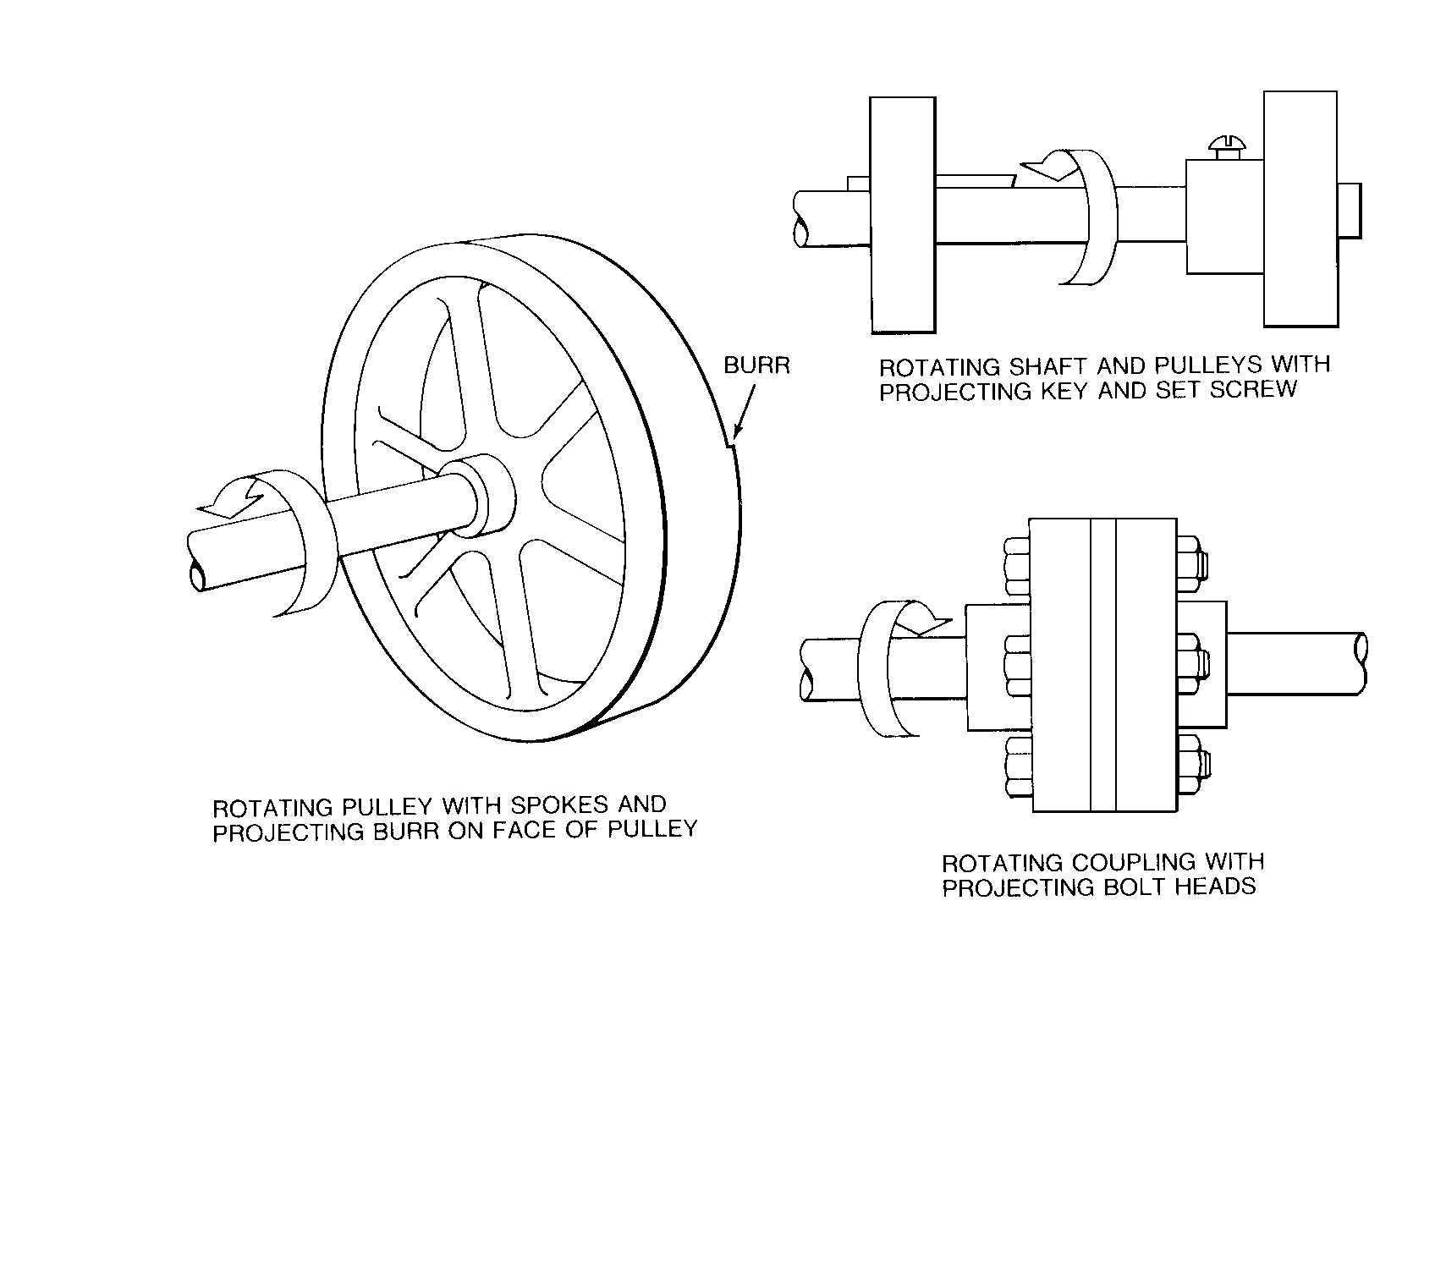
Rotating Parts
Notes:
These are examples of rotating parts

Slide 7
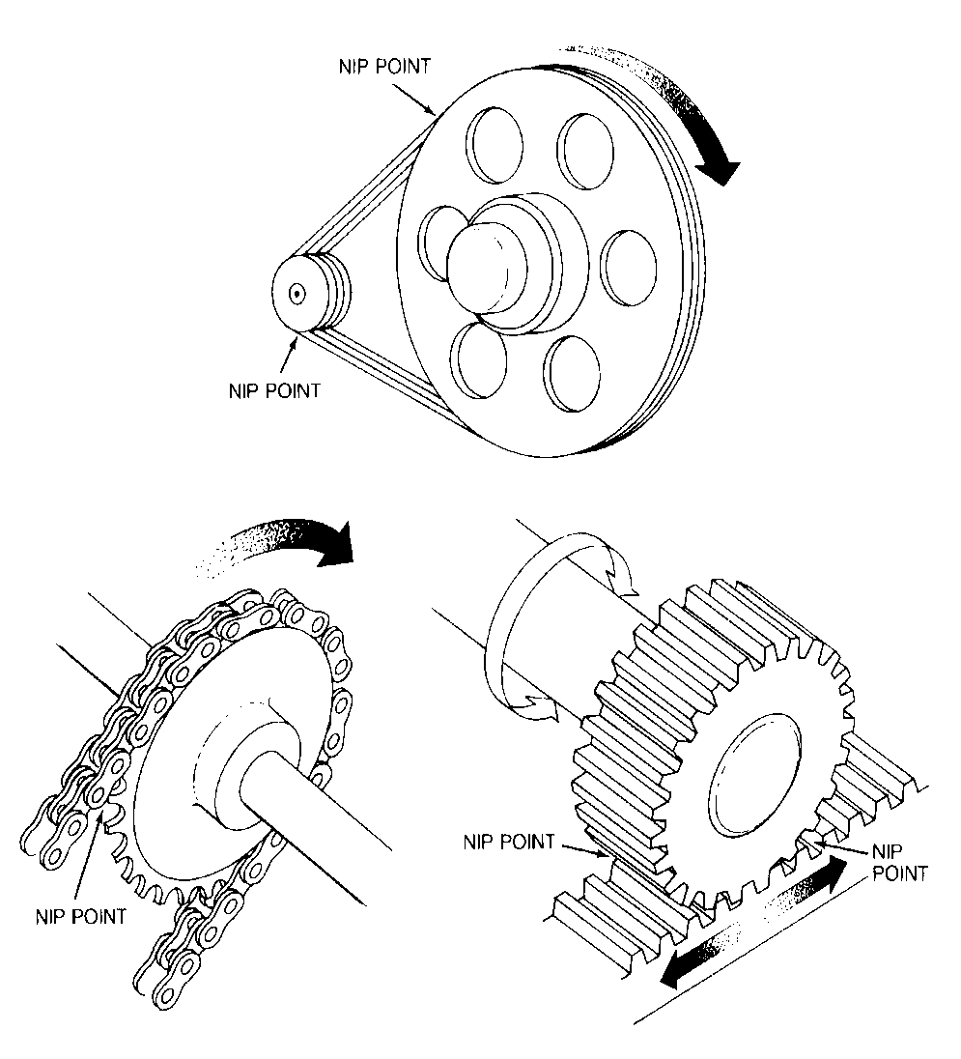
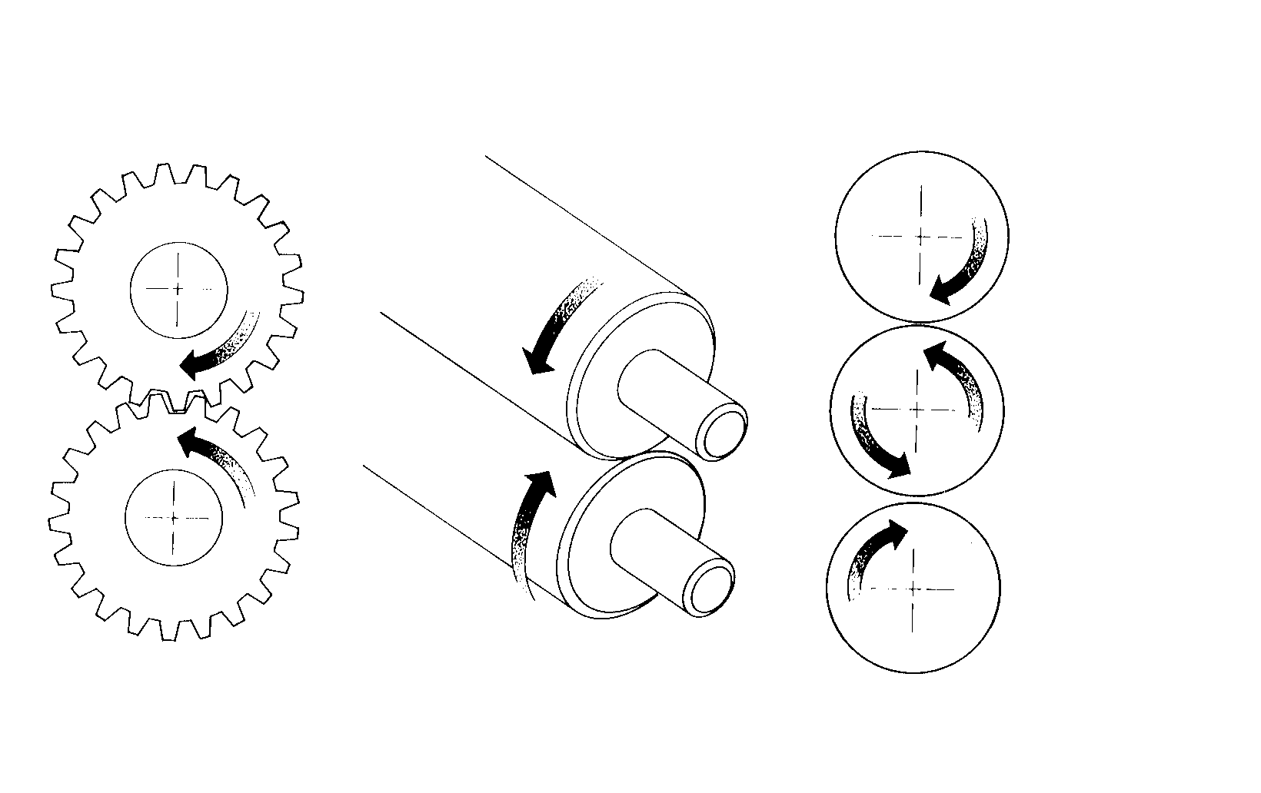
In-Running Nip Points
Rotating cylinders
Belt and pulley
Chain and sprocket
Rack and pinion
Notes:
In-running nip point hazards are caused by the rotating parts on machinery. There are three main types of in-running nips.
Parts can rotate in opposite directions while their axes are parallel to each other. These parts may be in contact (producing a nip point) or in close proximity to each other (where the stock fed between the rolls produces the nip points). This danger is common on machinery with intermeshing gears and rotating cylinders.
Another type of nip point is created between rotating and tangentially moving parts; for example, a chain and a sprocket, a rack and pinion, or the point of contact between a power transmission belt and its pulley.
Nip points can also occur between rotating and fixed parts which create a shearing and crushing action; for example, flywheels and conveyors

Slide 8
Requirements for Safeguards
Prevent contact - prevent worker’s body or clothing from contacting hazardous moving parts
Secure - firmly secured to machine and not easily removed
Protect from falling objects - ensure that no objects can fall into moving parts
Create no new hazards - must not have shear points, jagged edges or unfinished surfaces
Create no interference - must not prevent worker from performing the job quickly and comfortably
Notes:
Prevent Contact - A good safeguarding system eliminates the possibility of the operator or other workers placing parts of their bodies near hazardous moving parts.
Secure - A safeguard that can easily be made ineffective is no safeguard at all. Guards and safety devices should be made of durable material that will withstand the conditions of normal use and be firmly secured to the machine.
Protect from falling objects - A small tool which is dropped into a cycling machine could easily cause a jam and problem.
Create no new hazards - A safeguard defeats its own purpose if it creates a hazard of its own.
Create no interference - Any safeguard which impedes a worker from performing a job quickly and comfortably might soon be overridden or disregarded. Proper safeguarding can actually enhance efficiency since it can relieve the worker’s apprehensions about injury.

Slide 9
Methods of Machine Safeguarding
Guards
    Fixed
    Interlocked
    Moveable/adjustable
    Self-adjusting
Devices
    Presence sensing
    Safety controls (tripwire cable, two-hand control, etc.)
    Gates
Location/distance
Miscellaneous aids
    Awareness barriers
    Protective shields
Notes:
Describe these types of guards in your facility

Slide 10
Fixed Guard
Provides a barrier - a permanent part of the machine, preferable to all other types of guards
These type of guards should be secured with fasteners that require a tool for removal.
Notes:
As a general rule, power-transmission apparatus is best protected by fixed guards that enclose the danger area. For hazards at the point of operation, where moving parts actually perform work on stock, several kinds of safeguarding are possible.

Slide 11
Interlocked Guards
When this type of guard is opened or removed, the tripping mechanism and/or power automatically shuts off or disengages, and the machine cannot cycle or be started until the guard is back in place.
Notes:
An interlocked guard may use electrical, mechanical, hydraulic, or pneumatic power or any combination of these. Replacing the guard should not automatically restart the machine.
These are the lowest level of protection and should not be relied upon as the only safety device.

Slide 12
Moveable Guard
Provides a barrier which may be removed or moved out of the way to facilitate a variety of production operations.
Notes:
Moveable guards are useful because they can be used in areas where more frequent access is needed – Flexible guards are similar in that they are movable by accommodating various sizes of stock, but, because they require adjusting, they are subject to human error.

Slide 13
Trip Wire/Cables
Device located around or in front of the danger area
Operator must be able to reach the cable to stop the machine in time
Notes:
Trip wires andcables must be manually reset to restart the machine.

Slide 14
Two-Hand Control
Requires constant, concurrent pressure to activate the machine
The operator’s hands are required to be at a safe location (on control buttons) and at a safe distance from the danger area while the machine completes its closing cycle
.
Notes:
This kind of control requires a part-revolution clutch, brake, and brake monitor if used on a power press as shown.
A similar device, known as a two-hand trip, requires concurrent application of both of the operator’s control buttons to activate the machine cycle, after which the hands are free. This device is used with machines equipped with full-revolution clutches. The trips must be placed far enough from the point of operation to make it impossible for the operators to move their hands from the trip buttons or handles into the point of operation before the first half of the cycle is completed to prevent them from being accidentally placed in the danger area prior to the slide/ram or blade reaching the full “down” position.

Slide 15
Gate
Movable barrier device which protects the operator at the point of operation before the machine cycle can be started
If the gate does not fully close, machine will not function
Notes:
Another potential application of this type of device is where the gate is a component of a perimeter safeguarding system. A gate may provide protection not only to the operator but to pedestrian traffic as well.

Slide 16
Guarding by Location/Distance
Locate the machine or its dangerous moving parts so that they are not accessible or do not present a hazard to a worker during normal operation
Maintain a safe distance from the danger area
Notes:
Operator controls may be located at a safe distance from the machine if there is no reason for the operator to tend it.
Another approach is to locate the machine so that a plant design feature, such as a wall, protects the worker and other personnel. Enclosure walls or fences can also restrict access to machines. Another possible solution is to have dangerous parts located high enough to be out of the normal reach of any worker.

Slide 17
Power-Transmission Apparatus
Power-transmission apparatus (shafting, flywheels, pulleys, belts, chain drives, etc must be completely encased with guarding.

Slide 18
Machine Safety Responsibilities
Management
    Ensure all machinery is properly guarded
Supervisors
    Train employees on specific guard rules in their areas
    Ensure machine guards remain in place and are functional
    Immediately correct machine guard deficiencies
Employees
    Do not remove guards unless machine is locked and tagged
    Report machine guard problems to supervisors immediately
    Do not operate equipment unless guards are in place

Slide 19
Training
Operators should receive training on the following:
Hazards associated with particular machines
How the safeguards provide protection and the hazards for which they are intended
How and why to use the safeguards
How and when safeguards can be removed and by whom
What to do if a safeguard is damaged, missing, or unable to provide adequate protection

Slide 20
Summary
Safeguards are essential for protecting workers from needless and preventable machinery-related injuries
The point of operation, as well as all parts of the machine that move while the machine is working, must be safeguarded
A good rule to remember is: Any machine part, function, or process which may cause injury must be safeguarded

Slide 21
Lockout/Tagout
Notes:
The purpose of this section is to make employees aware of machines and application of lockout tagout at your company
Site specific equipment and procedures should be implemented into the slide materials and discussion

Slide 22
Hazardous Energy Control
Commonly known as lockout/tagout
Establishes minimum requirements for:
  Service and maintenance of equipment …with
  Unexpected energization, start up or release
of stored energy
  Which could cause injury to employees

Slide 23
Lockout/Tagout
All printing facilities must comply if you perform any service or maintenance on any powered equipment
Designed to protect employees from injury during Service and Maintenance
Must be Site Specific

Slide 24
Application
Application of lockout/tagout is required:
  When servicing and/or maintaining machines or equipment
  If it is necessary to remove a guard or bypass safety device or interlock
  If the potential to be exposed to hazardous energy exists

Slide 25
Modes of Operations
Production –
Equipment is used in normal production
Service and Maintenance –
Extensive service
      Operator cannot maintain exclusive control
      Guards /barriers removed
Minor Service -
Non-extensive service & (Routine, Repetitive, Integral)

Slide 26
Production Mode
Machine Guarding Applies:
Panels Fixed Guards
Cages/Doors Movable Guards
Covers Nip Guards
Trip Guards Barrier Guards
(Electronic Safety Devices)
Notes:
Refresh the discussion on machine guarding

Slide 27
Service and Maintenance Mode
Lockout/Tagout Applies:
  Energy Control Procedures
  Application of Lockout/Tagout Materials

Slide 28
Minor Service Mode
- Minor tool changes, adjustments or other minor servicing activities, which take place during normal production operations if they are routine, repetitive, and integral to the use of the equipment for production”
Must take alternative protective measures in lieu of using lockout/tagout to qualify
Notes:
Identify the minor services you allow and that qualify within your operations

Slide 29
Minor Service
Consider exposure during:
Set-up
Make-ready
Equipment cleaning
Clearing jams and miss-feeds
Notes:
Discuss what tasks can involve minor service
See if there are additional tasks not already identified

Slide 30
Energy Types
Typical:
  Electrical – Current through wires & circuits
  Hydraulic – Pressurized fluid through pipes/hoses
  Pneumatic – Compressed air or gas through pipes/hoses
  Mechanical – Stored energy as in tension springs
Notes:
Identify the sources your facility uses and to which machines
Ask what other sources might have an effect
List all sources in your facility and discuss

Slide 31
Energy Hazards
  Electrical … Electrocution/Burns
  Hydraulic … Punctures/Flying Debris
  Pneumatic … Punctures/Flying Debris
  Mechanical … Crushing/Cutting/ Tearing
Notes:
Discuss any previous injuries experienced with these hazardous energies – give some examples

Slide 32
Individual Lockout Procedures
Review energy control procedures
Notify all affected employees
Shut down equipment/machine
Locate and isolate the energy sources
Lockout the energy controls
Test the operating controls
Return the controls to “off” and re-test
Perform service /maintenance
Notes:
Explain the steps
Modify this to match your facilities established sequence procedures

Slide 33
Energy Control Procedure
MACHINE SPECIFIC !!!
Energy Type & Magnitude | Cut Off Location | Steps for Isolation
Electrical – 220 volts | Knife switch located on non-operator side of machine, labeled ABC123 | Flip the knife switch handle to off position and insert lock through aligned holes in the handle and breaker box. Attach tag with the Authorized Employee’s name and date.
Notes:
Utilize the site specific equipment procedure as an example of this process.
Mention your disciplinary action or means of accountability

Slide 34
Lock Requirements
Lockout locks must be:
  Durable
  Standardized in use
  Secure enough so as not easily removed
  Identified with name of who installed it
Notes:
This would be a good time to pass around the specific devices that you use at your company. Emphasizing the identity of the user, point out the fact of who should have the keys to these locks.

Slide 35
Tag Requirements
Lockout/tagout tags must be:
  Uniform in design
  Easy to read
  Durable
  Secure enough so as not easily removed
  Identified with the name of who installed it
Notes:
This would be a good time to pass around the specific devices that you use at your company. Emphasizing the identity of the user, point out the limitations of tags and of using only tagout procedures.

Slide 36
Group Lockout Procedures
Same as individual lockout except:
  One employee has primary responsibility
  This employee ensures groups safety
  Each member of the group attaches a lock
Notes:
Explain your company policy for group lockouts
Primary responsibility for a set number of employees working under the protection of a group lockout or tagout device must be vested in a single authorized employee.
The single authorized employee must determine the exposure status of individual group members.
If there will be more than one crew, department, or group involved in the activity, a single authorized employee must be designated to coordinate affected workforces and to ensure continuity of protection.
Each authorized employee must affix a personal lockout or tagout device to the machine or equipment when work begins and remove it when work is completed.

Slide 37
Restoring Equipment to Service
Make sure all employees are clear
Remove all tools from equipment area
Reinstall all guards and safety devices
Remove lockout devices
Turn on energy and test equipment
Turn off equipment
Notify employees of resumed operation
Notes:
Refer to your company specific procedures and sequence

Slide 38
Unauthorized Lock Removal
Consequences of unauthorized removal
  See company policy
  Follow and understand the company policy
For Your safety and the Authorized Employee
Notes:
Explain your policy on this topic
Explain your process of changing the locks upon completion of a shift and or the transfer of responsibility. Is there transfer of responsibility ?

Slide 39
Employee Roles
Authorized Employee –
  Employees trained and authorized to perform lockout/tagout procedures
Affected Employee –
  Immediate employees working with the machinery in question
Other Employees –
  Other employees able to access the area
Notes:
Authorized: The person who is trained and responsible for these locks
This might be - maintenance personnel - Set-up person
Affected: This can be any employee who works in the area or with the machinery serviced
Other: This can be persons like a customer or vendor

Slide 40
Training is Required…
  Before being assigned to perform service and maintenance
  When new equipment is introduced
  With changes in lockout/tagout equipment
  When annual reviews identify deficiencies
Notes:
Review who is trained and authorized in your facility
Authorized employees must receive training on the recognition of applicable hazardous energy sources, the type and magnitude of the energy available in the workplace, and the methods and means necessary for energy isolation and control.
Affected employees must receive training on the purpose and use of the energy control procedure.
Other employees (those whose work activities are or may be in an area where energy control procedures may be utilized) must be instructed about the procedure and about the prohibition relating to attempts to restart or reenergize machines or equipment that are locked out or tagged out.

Slide 41
Annual Reviews
This is not lockout/tagout training
It is a verification of:
  Accuracy of energy control procedures
  Competency of Authorized Employees
Notes:
Go over the steps your company has established for this task and who conducts the review

Slide 42
Summary
Only Authorized employees can perform lockout/tagout procedures
Always review energy control procedures before beginning any service and maintenance
When in doubt – always lockout!

Slide 43
Safe Work Practices

Slide 44
Benefits of Safe Work Practices
  Reduce work related injuries and illnesses
  Improve morale and productivity
  Reduce workers’ compensation costs
Notes:
Safe work practices are recommended for all printing facilities.
Having accidents has a traumatic effect on everyone.
On the business side , accidents are more expensive than most people realize because of the hidden costs. Some costs are obvious — for example, Workers’ Compensation claims which cover medical costs and indemnity payments for an injured or ill worker. These are the direct costs of accidents.
But what about the costs to train and compensate a replacement worker, repair damaged property, investigate the accident and implement corrective action, and to maintain insurance coverage? Then there are the costs related to schedule delays, added administrative time, lower morale, increased absenteeism, and poorer customer relations. These are the indirect costs of accidents.

Slide 45
Major Elements
  Effective Safe Work Practices includes the following elements:
    Management commitment and employee involvement
    Worksite analysis
    Hazard prevention and control
    Employee safety training
Notes:
The best practices involve every level of the organization, instilling a safety culture that reduces accidents for workers and improves the bottom line for managers.
What are the common characteristics of safe practices?
Management believes that safety on the job is as important a company goal as other organizational objectives, such as cost control, quality, and productivity.
Individuals within the organization believe they have a right to a safe and healthy workplace.
- Each person accepts personal responsibility for ensuring his or her own safety .
- Everyone believes he or she has a duty to protect the safety of others.

Slide 46
Management Commitment and Employee Involvement
  These are complementary elements
  Management commitment provides motivation and resources
  Employee involvement allows workers to develop and express commitment to safety
Notes:
Management must be committed to safety as much as other organizational purposes.
Management leadership and employee involvement are tied together because one is not effective without the other. A plant manager can be totally committed, but if employees follow blindly or are not involved, problems will only temporarily be solved.

Slide 47
Policy and Goals
  Clearly state the company’s safety policy
  Communicate the goal and objective for the safety program
  Top management supports the program
Notes:
Insert your company policies and goals

Slide 48
Employee Involvement
  Employees need to be involved in the program and in decisions that affect their safety
  Communicate their responsibility for all program aspects
Notes:
Employees must commit to safety for themselves and fellow workers.
Examples: inspection or hazard analysis teams; developing or revising safe work rules; training new hires or co-workers; assisting in accident investigations.

Slide 49
Responsibility
  Employees responsible for safety programs must have authority and resources
  Managers, supervisors, and employees must be held accountable for meeting their responsibilities
  Machine operations must be reviewed regularly, to evaluate, identify deficiencies, and correct, as needed

Slide 50
Worksite Analysis
  Involves a worksite examination to identify:
    Existing hazards
    Conditions and operations where changes might occur to create hazards
  Management must actively analyze the work and the worksite to anticipate and prevent harmful occurrences
Notes:
Management must provide the resources and authority so all personnel can find the hazards in the worksite and, once found, eliminate or control those hazards.

Slide 51
Baseline Survey
  Conduct a baseline survey for safety
  Job Hazard Analysis
  Who gets involved:
    Employees
    Machine Operators
    Supervisors
Notes:
Job Hazard Analysis
This involves observing and recording each step of a job, identifying existing or potential job hazards and determining the best way to perform the job to reduce or eliminate hazards. Jobs that were initially designed to be safe may change over time so they have hazards or require unsafe operations. Job safety analysis should form a base for the comprehensive survey.
Baseline survey: at a minimum, all machinery and operations in the plant should be inventoried, and a review of amputation risks identified.

Slide 52
Safety Inspections
  Conduct regular site inspections
  Establish daily work area inspection procedures
  Develop and use checklists
  Provide a system for employees, without fear of reprisal, to notify management about hazardous conditions
Notes:
Routine site safety inspections are designed to catch hazards missed at other stages. This type of inspection should be done at regular intervals. In addition, procedures should be established that provide a daily inspection of the work area.
You can use the checklists provided in this program or develop your own
Important things to remember about inspections are:
- Inspections should cover every part of the operation
- They should be done at regular intervals
- In-house inspectors should be trained to recognize and control hazards
- Identified hazards should be tracked to correction
Information from inspections should be used to improve the hazard prevention and control program.

Slide 53
Additional Worksite Analysis
  Investigate accidents and “close-calls” incidents, so that their causes and means for prevention are identified
  Analyze injury trends, so that common causes can be identified and prevented
Notes:
The primary purpose of the investigation is to prevent future occurrences. Therefore, the results of the investigation should be used to initiate corrective action.
Examples are inspection records, workers’ compensation claims, and employee hazard reporting records.

Slide 54
Hazard Prevention and Control
  Start by determining that a hazard or potential hazard exists
  Where feasible, prevent hazards by effective design of job or job site
  If the hazard cannot be eliminated, use hazard controls
  Eliminate or control hazards in a timely manner

Slide 55
Controlling the Hazards
To prevent and control hazards:
  Engineering controls
  Safe work practices communicated
    Employee training
    Positive reinforcement
    Correction of unsafe practices
    Enforcement of rules and polices
Notes:
Engineering controls Where feasible and appropriate, the first and best strategy is to control the hazard at its source. Engineering controls do this, unlike other controls that generally focus on the employee exposed to the hazard. The basic concept is that the work environment and the job itself should be designed to eliminate hazards or reduce exposure to hazards.
Safe Work Practices Include your company’s general workplace rules and other operation-specific rules. For example, even when a hazard is enclosed, exposure can occur when maintenance is necessary.

Slide 56
Safety Training
  Addresses the safety responsibilities of all personnel
  Incorporated into other training and job performance/practice
Notes:
Training is the backbone of this system. For management to lead, for personnel to analyze the worksite for hazards, and for hazards to be eliminated or controlled, everyone involved must be trained. The scope of the training depends on the size and complexity of the worksite and the hazards involved.

Slide 57
Safety Orientation
  Orientation training must be given prior to beginning job duties
  Employees must understand the hazards they may be exposed to and how to prevent harm to themselves and others from hazard exposure

Slide 58
Supervisor Responsibilities
  Analyzes work to identify potential hazards in area of responsibility
  Maintain physical protections in work areas
  Reinforce employee training through performance feedback and, if needed, enforcement of safe work practices
Notes:
Managers must understand their safety responsibilities

Slide 59
Summary
Effective safe work practices:
  Reduce work related injuries and illnesses
  Improve morale and productivity
  Reduce workers’ compensation costs
  Includes these elements:
    Management commitment and employee involvement
    Worksite analysis
    Hazard prevention and control
    Employee safety training

